Slide 1
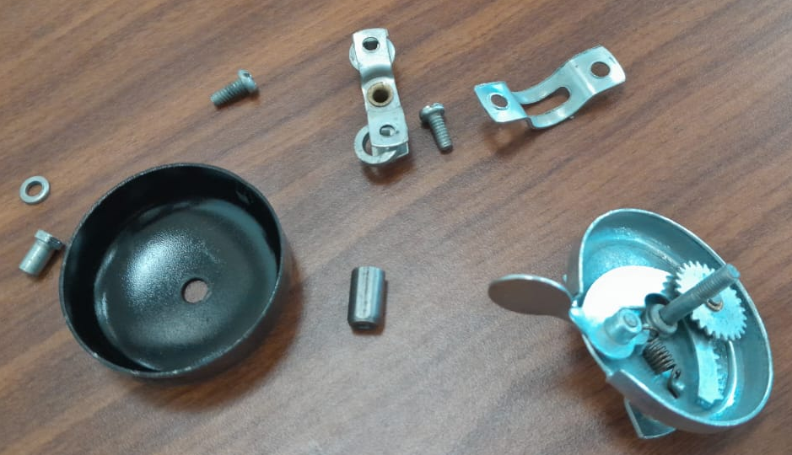
TOTAL PARTS : 10
(1) BELL COVER - 1
(2) SPACER - 1
(3) WASHER - 1
(4) HEX HEAD HOLLOW SCREW - 1
(5) SCREW - 2
(6) CLAMP - 1
(7) BELL BASE - 1
(8) SPRING - 1
(9) GEAR - 1
(10) WASHER HANDLE ARM - 1
The Patent for the Clamp of the cycle bell was filled on December 6th, 2016, by Kimura Yuta in Japan.
CYCLE BELL
CS23I1027 YERRAGOLAM HARITH

